Slide 1


Next session
Microteaching (5min each)
You will have to
Teach any hard-academic concept using SUTD aligned methods
This is NOT your PhD project presentation- BUT you can teach concepts from your PhD Research
Engage your students
Assess student learning
Provide constructive feedback to students
Peers will provide feedback. Tutor will grade.

Slide 2
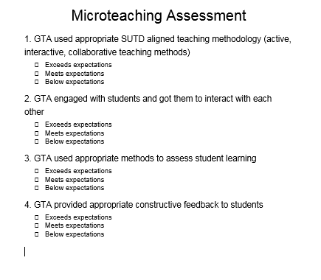
Self Evaluation- Peer Feedback

Slide 3
Reference to help you plan
Template to help you design your Microteaching Session
https://uwaterloo.ca/centre-for-teaching-excellence/sites/ca.centre-for-teaching-excellence/files/uploads/files/Arts-%20Crystal%20Tse%20-%20Lesson%20Plan.pdf

Slide 4

Final Grades and Certification
Post Test +Reflection 70%
Microteaching 30%
Certification Pass ( 50%)
Certification event : To be announced

